Slide 1
Mining Knowledge Graphs from Text
WSDM 2018
JAY PUJARA, SAMEER SINGH

Slide 2

Tutorial Overview
https://kgtutorial.github.io
Part 1: Knowledge Graphs
Part 2: Knowledge Extraction
Part 3: Graph Construction
Part 4: Critical Analysis

Slide 3
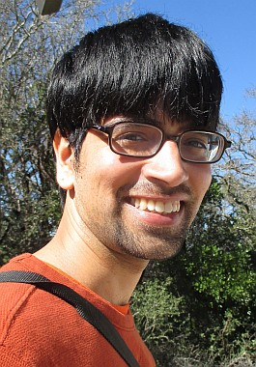



Tutorial Outline
Knowledge Graph Primer
Knowledge Extraction Primer
Knowledge Graph Construction
[Jay]
[Jay]
a. Probabilistic Models [Jay]
Coffee Break
b. Embedding Techniques [Sameer]
4. Critical Overview and Conclusion [Sameer]

Slide 4
Knowledge Graph Construction
TOPICS:
PROBLEM SETTING
PROBABILISTIC MODELS
EMBEDDING TECHNIQUES

Slide 5
Knowledge Graph Construction
TOPICS:
PROBLEM SETTING
PROBABILISTIC MODELS
EMBEDDING TECHNIQUES

Slide 6





Reminder: Basic problems
E₁
E₂
E₃
A₁ A₂
Who are the entities (nodes) in the graph?
What are their attributes and types (labels)?
A₁ A₂
How are they related (edges)?
A₁ A₂

Slide 7
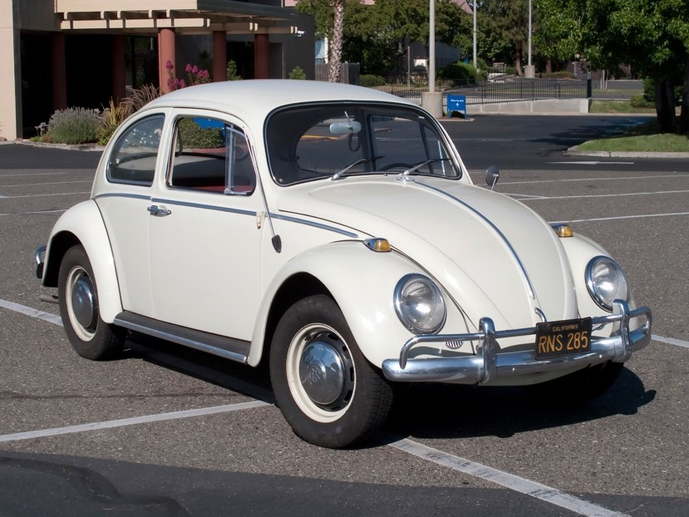
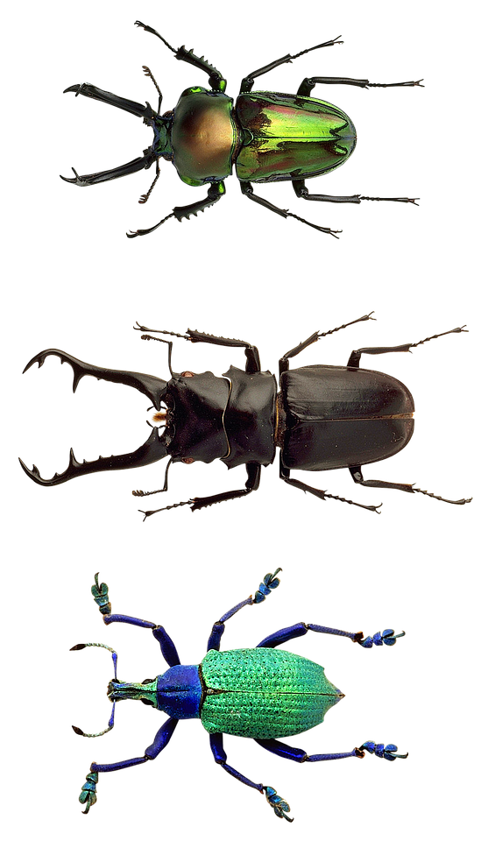
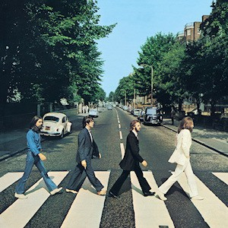
Graph Construction Issues
Extracted knowledge is:
ambiguous:
Ex: Beetles, beetles, Beatles
Ex: citizenOf, livedIn, bornIn

Slide 8

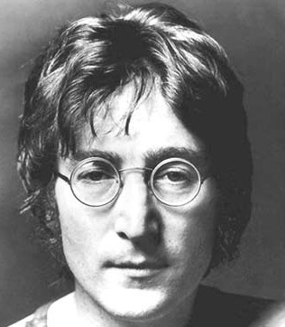
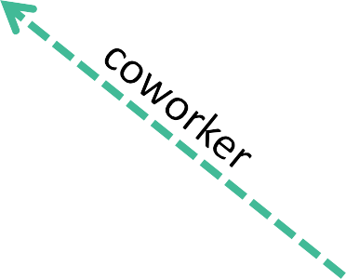
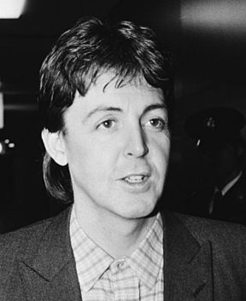
Graph Construction Issues
Extracted knowledge is:
ambiguous
incomplete
Ex: missing relationships
Ex: missing labels
Ex: missing entities

Slide 9
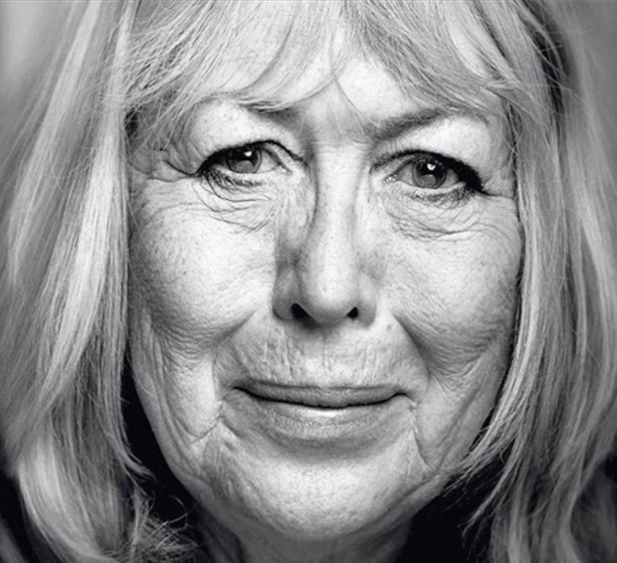
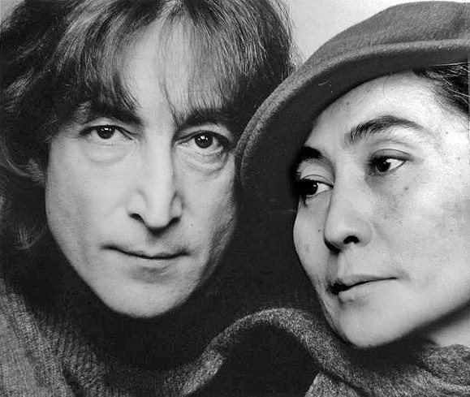
Graph Construction Issues
Extracted knowledge is:
ambiguous
incomplete
spouse
inconsistent
Ex: Cynthia Lennon, Yoko Ono
Ex: exclusive labels (alive, dead)
Ex: domain-range constraints
spouse

Slide 10


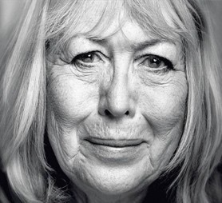
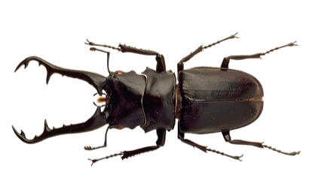
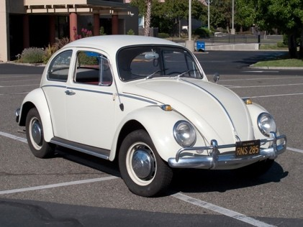
Graph Construction Issues
Extracted knowledge is:
ambiguous
incomplete
inconsistent

Slide 11
Graph Construction approach
Graph construction cleans and completes extraction graph
Incorporate ontological constraints and relational patterns
Discover statistical relationships within knowledge graph

Slide 12
Graph construction的三個問題分別是甚麼?
Q & A

Slide 13
Knowledge Graph Construction
TOPICS:
PROBLEM SETTING
PROBABILISTIC MODELS
EMBEDDING TECHNIQUES

Slide 14
Graph Construction
Probabilistic Models
TOPICS:
OVERVIEW
GRAPHICAL MODELS
RANDOM WALK METHODS

Slide 15
Graph Construction
Probabilistic Models
TOPICS:
OVERVIEW
GRAPHICAL MODELS
RANDOM WALK METHODS

Slide 16
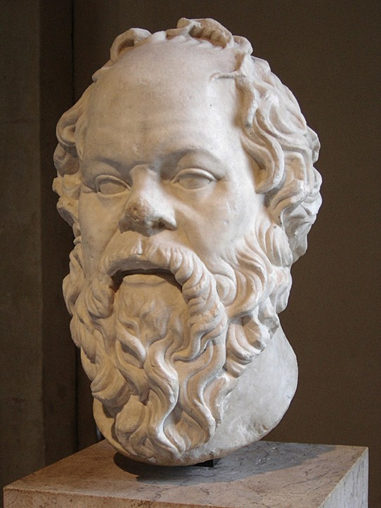
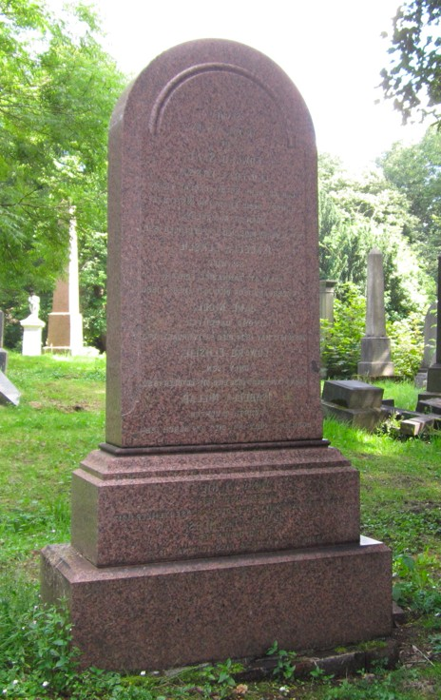
Beyond Pure Reasoning
Classical AI approach to knowledge: reasoning
Lbl(Socrates, Man) & Sub(Man, Mortal) -> Lbl(Socrates, Mortal)

Slide 17

Beyond Pure Reasoning
Classical AI approach to knowledge: reasoning
Lbl(Socrates, Man) & Sub(Man, Mortal) -> Lbl(Socrates, Mortal)
Reasoning difficult when extracted knowledge has errors

Slide 18
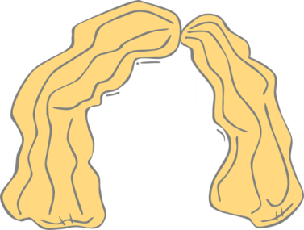
Beyond Pure Reasoning
Classical AI approach to knowledge: reasoning
Lbl(Socrates, Man) & Sub(Man, Mortal) -> Lbl(Socrates, Mortal)
Reasoning difficult when extracted knowledge has errors
Solution: probabilistic models
P(Lbl(Socrates, Mortal)|Lbl(Socrates,Man)=0.9)

Slide 19
Graph Construction
Probabilistic Models
TOPICS:
OVERVIEW
GRAPHICAL MODELS
RANDOM WALK METHODS

Slide 20
Graphical Models: Overview
Define joint probability distribution on knowledge graphs
Each candidate fact in the knowledge graph is a variable
Statistical signals, ontological knowledge and rules parameterize the dependencies between variables
Find most likely knowledge graph by optimization/sampling

Slide 21
Knowledge Graph Identification
Define a graphical model to perform all three of these tasks simultaneously!
E₁
E₂
E₃
A₁ A₂
Who are the entities (nodes) in the graph?
What are their attributes and types (labels)?
A₁ A₂
A₁ A₂
How are they related (edges)?
PUJARA+ISWC13

Slide 22
Knowledge Graph Identification
A₁ A₂
E
1
P(Who, What, How|Extractions)
E₂
A₁ A₂
E₃
A₁ A₂
PUJARA+ISWC13

Slide 23
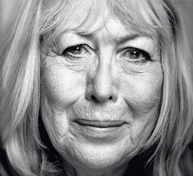


Probabilistic Models
Use dependencies between facts in KG
Probability defined jointly over facts
P=0
P=0.25
P=0.75

Slide 24
What determines probability?
Statistical signals from text extractors and classifiers

Slide 25
What determines probability?
Statistical signals from text extractors and classifiers
P(R(John,Spouse,Yoko))=0.75; P(R(John,Spouse,Cynthia))=0.25
LevenshteinSimilarity(Beatles, Beetles) = 0.9

Slide 26
What determines probability?
Statistical signals from text extractors and classifiers
Ontological knowledge about domain

Slide 27
What determines probability?
Statistical signals from text extractors and classifiers
Ontological knowledge about domain
Functional(Spouse) & R(A,Spouse,B) -> !R(A,Spouse,C)
Range(Spouse, Person) & R(A,Spouse,B) -> Type(B, Person)

Slide 28
What determines probability?
Statistical signals from text extractors and classifiers
Ontological knowledge about domain
Rules and patterns mined from data

Slide 29
What determines probability?
Statistical signals from text extractors and classifiers
Ontological knowledge about domain
Rules and patterns mined from data
R(A, Spouse, B) & R(A, Lives, L) -> R(B, Lives, L)
R(A, Spouse, B) & R(A, Child, C) -> R(B, Child, C)

Slide 30
What determines probability?
Statistical signals from text extractors and classifiers
P(R(John,Spouse,Yoko))=0.75; P(R(John,Spouse,Cynthia))=0.25
LevenshteinSimilarity(Beatles, Beetles) = 0.9
Ontological knowledge about domain
Functional(Spouse) & R(A,Spouse,B) -> !R(A,Spouse,C)
Range(Spouse, Person) & R(A,Spouse,B) -> Type(B, Person)
Rules and patterns mined from data
R(A, Spouse, B) & R(A, Lives, L) -> R(B, Lives, L)
R(A, Spouse, B) & R(A, Child, C) -> R(B, Child, C)

Slide 31

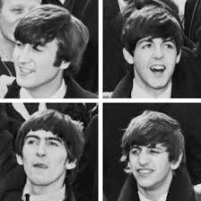

Example: The Fab Four

Slide 32
Illustration of KG Identification
Uncertain Extractions:
.5: Lbl(Fab Four, novel)
.7: Lbl(Fab Four, musician)
.9: Lbl(Beatles, musician)
.8: Rel(Beatles,AlbumArtist,
Abbey Road)
PUJARA+ISWC13; PUJARA+AIMAG15

Slide 33
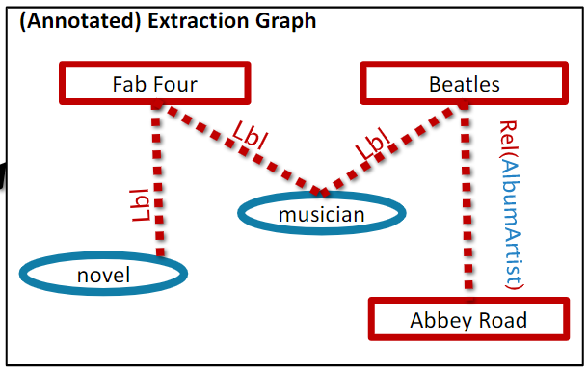

Illustration of KG Identification
Uncertain Extractions:
.5: Lbl(Fab Four, novel)
.7: Lbl(Fab Four, musician)
.9: Lbl(Beatles, musician)
.8: Rel(Beatles,AlbumArtist,
Abbey Road)
PUJARA+ISWC13; PUJARA+AIMAG15

Slide 34
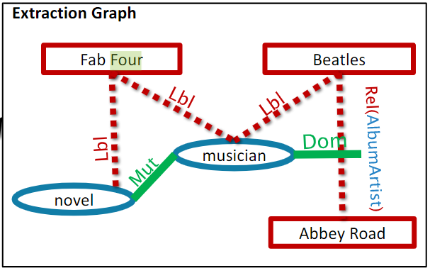
Illustration of KG Identification
Uncertain Extractions:
.5: Lbl(Fab Four, novel)
.7: Lbl(Fab Four, musician)
.9: Lbl(Beatles, musician)
.8: Rel(Beatles,AlbumArtist,
Abbey Road)
Ontology:
Dom(albumArtist, musician) Mut(novel, musician)
PUJARA+ISWC13; PUJARA+AIMAG15

Slide 35
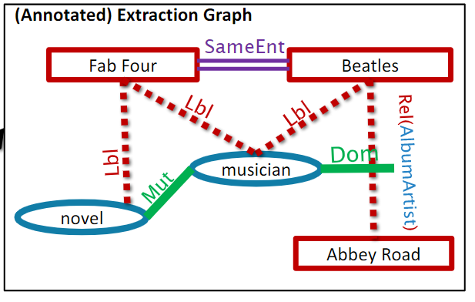
Illustration of KG Identification
Uncertain Extractions:
.5: Lbl(Fab Four, novel)
.7: Lbl(Fab Four, musician)
.9: Lbl(Beatles, musician)
.8: Rel(Beatles,AlbumArtist,
Abbey Road)
Ontology:
Dom(albumArtist, musician) Mut(novel, musician)
Entity Resolution:
SameEnt(Fab Four, Beatles)
PUJARA+ISWC13; PUJARA+AIMAG15

Slide 36

Illustration of KG Identification
Uncertain Extractions:
.5: Lbl(Fab Four, novel)
.7: Lbl(Fab Four, musician)
.9: Lbl(Beatles, musician)
.8: Rel(Beatles,AlbumArtist,
Abbey Road)
Ontology:
Dom(albumArtist, musician) Mut(novel, musician)
Entity Resolution:
SameEnt(Fab Four, Beatles)
After Knowledge Graph Identification
Beatles Fab Four
 |  | Abbey Road
Lbl
Rel(AlbumArtist)
musician
PUJARA+ISWC13; PUJARA+AIMAG15

Slide 37
Lbl(x,y) → ? Rel(x,r,y) → ? Dom(x,y) → ? Mul(x,y) → ? SameEnt(x,y) → ?
Q & A

Slide 38
Defining graphical models
Many options for defining a graphical model
We focus on two approaches, MLNs and PSL, that use rules
MLNs treat facts as Boolean, use sampling for satisfaction
MLN(Markov logic network)
PSL infers a “truth value” for each fact via optimization
PSL(Probabilistic soft logic)
37

Slide 39

Rules for KG Model
100: | Subsumes(L1,L2) | & | Label(E,L1) | -> | Label(E,L2)
100: | Exclusive(L1,L2) | & | Label(E,L1) | -> | !Label(E,L2)
100: | Inverse(R1,R2) | & | Relation(R1,E,O) | -> | Relation(R2,O,E)
100: | Subsumes(R1,R2) | & | Relation(R1,E,O) | -> | Relation(R2,E,O)
100: | Exclusive(R1,R2) | & | Relation(R1,E,O) | -> | !Relation(R2,E,O)
100: | Domain(R,L) | & | Relation(R,E,O) | -> | Label(E,L)
100: | Range(R,L) | & | Relation(R,E,O) | -> | Label(O,L)
10: | SameEntity(E1,E2) | & | Label(E1,L) | -> | Label(E2,L)
10: | SameEntity(E1,E2) | & | Relation(R,E1,O) | -> | Relation(R,E2,O)
1: | Label_OBIE(E,L) |  |  | -> | Label(E,L)
1: | Label_OpenIE(E,L) |  |  | -> | Label(E,L)
1: 1: | Relation_Pattern(R,E,O) |  |  | -> | Relation(R,E,O) !Relation(R,E,O)
1: |  |  |  |  | !Label(E,L)
JIANG+ICDM12; PUJARA+ISWC13, PUJARA+AIMAG15 38

Slide 40
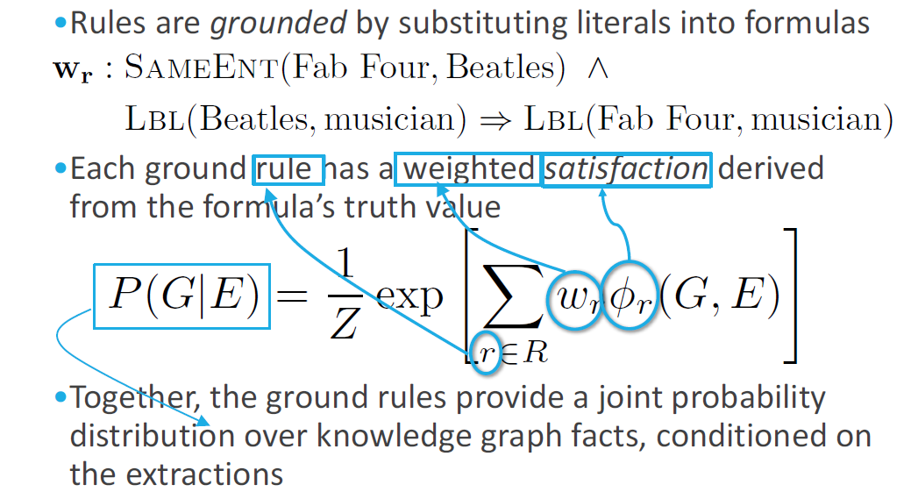
Rules to Distributions
JIANG+ICDM12; PUJARA+ISWC13

Slide 41
Illustration of KG Identification
G
Uncertain Extractions:
.5: Lbl(Fab Four, novel)
.7: Lbl(Fab Four, musician)
.9: Lbl(Beatles, musician)
.8: Rel(Beatles,AlbumArtist,
Abbey Road)
Ontology:
Dom(albumArtist, musician) Mut(novel, musician)
Entity Resolution:
SameEnt(Fab Four, Beatles)
E
After Knowledge Graph Identification
Beatles Fab Four
 |  | Abbey Road
Lbl
Rel(AlbumArtist)
musician
PUJARA+ISWC13; PUJARA+AIMAG15

Slide 42
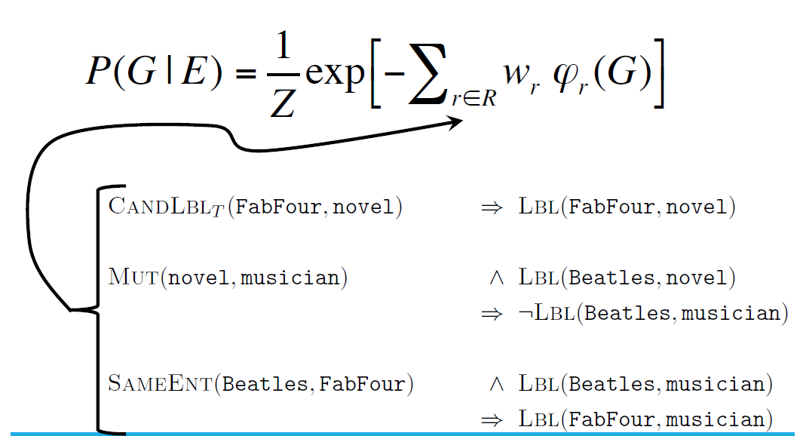
Probability Distribution over KGs

Slide 43
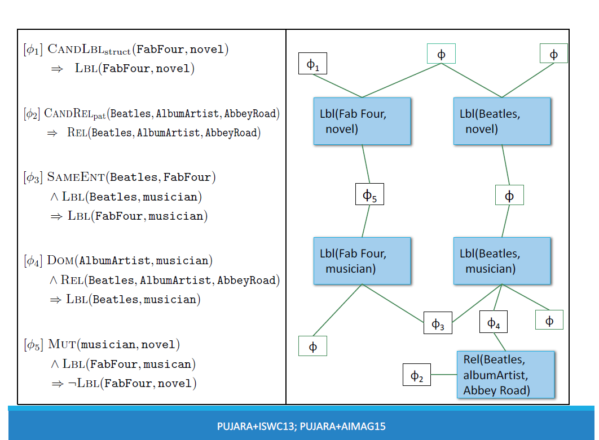
[$₁] CandLbl_{struct}(FabFour, novel) ) Lbl(FabFour, novel) [$₂] CandRel_{pat}(Beatles, AlbumArtist, AbbeyRoad) ) Rel(Beatles, AlbumArtist, AbbeyRoad) [$₃] SameEnt(Beatles, FabFour) ^ Lbl(Beatles, musician) ) Lbl(FabFour, musician) [$₄] Dom(AlbumArtist, musician) ^ Rel(Beatles, AlbumArtist, AbbeyRoad) ) Lbl(Beatles, musician) [$₅] Mut(musician, novel) ^ Lbl(FabFour, musican) ) ¬Lbl(FabFour, novel) | φ₁ Lbl(Fab Four, novel) φ₅ Lbl(Fab Four, musician) φ | φ₂ | φ φ₃ | Lbl(Beatles, novel) φ Lbl(Beatles, musician) φ₄ Rel(Beatles, albumArtist, Abbey Road) | φ φ
PUJARA+ISWC13; PUJARA+AIMAG15

Slide 44
Q & A

Slide 45
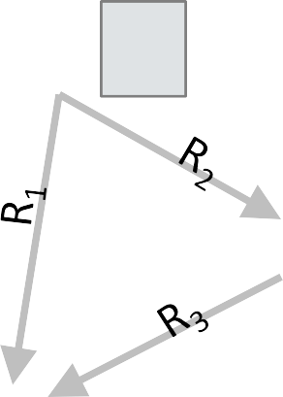
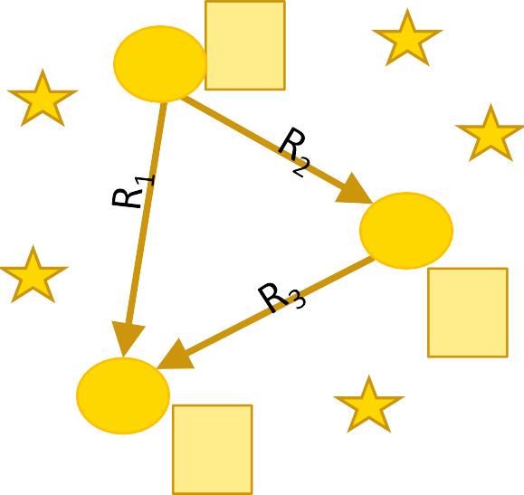



How do we get a knowledge graph?
Have: P(KG) forall KGs
Need: best KG
A₁
E₁ A₂
A₁
E₁ A₂
P( )
E₂
E₂
A₁ A₂
A₁ A₂
E₃
E₃
A A
1
2
A₁ A₂
MAP inference: optimizing over distribution to find the best knowledge graph

Slide 46
Inference and KG optimization
Finding the best KG satisfying weighed rules: NP Hard
MLNs [discrete]: Monte Carlo sampling methods
Solution quality dependent on burn-in time, iterations, etc.
PSL [continuous]: optimize convex linear surrogate
Fast optimization, ¾-optimal MAX SAT lower bound

Slide 47
Graphical Models Experiments
Data: ~1.5M extractions, ~70K ontological relations, ~500 relation/label types
Task: Collectively construct a KG and evaluate on 25K target facts
Comparisons:
Extract Rules MLN PSL
Average confidences of extractors for each fact in the NELL candidates Default, rule-based heuristic strategy used by the NELL project
Jiang+, ICDM12 – estimates marginal probabilities with MC-SAT
Pujara+, ISWC13 – convex optimization of continuous truth values with ADMM
Running Time: Inference completes in 10 seconds, values for 25K facts
 | AUC | F1
Extract | .873 | .828
Rules | .765 | .673
MLN (Jiang, 12) | .899 | .836
PSL (Pujara, 13) | .904 | .853
JIANG+ICDM12; PUJARA+ISWC13

Slide 48
Graphical Models: Pros/Cons
BENEFITS
Define probability distribution over KGs
Easily specified via rules
Fuse knowledge from many different sources
DRAWBACKS
Requires optimization over all KG facts - overkill
Dependent on rules from ontology/expert
Require probabilistic semantics - unavailable

Slide 49
Graph Construction
Probabilistic Models
TOPICS:
OVERVIEW
GRAPHICAL MODELS
RANDOM WALK METHODS

Slide 50
Random Walk Overview
Given: a query of an entity and relation
Starting at the entity, randomly walk the KG
Random walk ends when reaching an appropriate goal
Learned parameters bias choices in the random walk
Output relative probabilities of goal states

Slide 51
Random Walk Illustration
Query: R(Lennon, PlaysInstrument, ?)

Slide 52
Random Walk Illustration
Query Q: R(Lennon, PlaysInstrument, ?)

Slide 53
Random Walk Illustration
Query Q: R(Lennon, PlaysInstrument, ?)

Slide 54
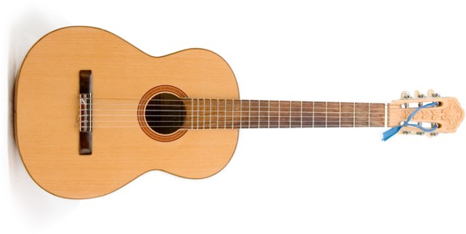
Random Walk Illustration
Query Q: R(Lennon, PlaysInstrument, ?)

Slide 55
Random Walk Illustration
Query Q: R(Lennon, PlaysInstrument, ?)
Path Weight of path
P(Q|𝝿=<coworker,playsInstrument>) W_{𝝿}

Slide 56
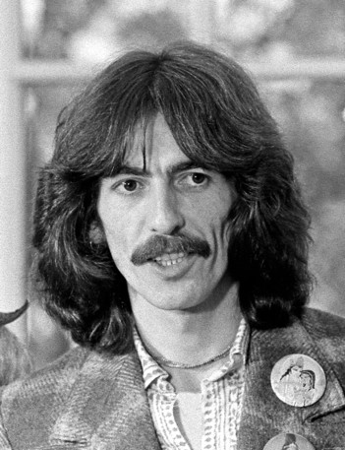
Random Walk Illustration
Query Q: R(Lennon, PlaysInstrument, ?)
P(Q|𝝿=<coworker,playsInstrument>) W_{𝝿}

Slide 57
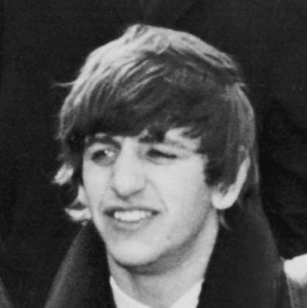
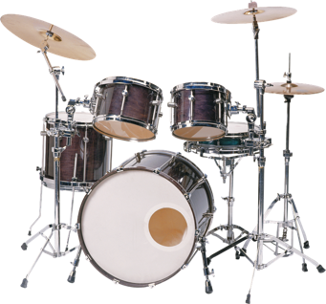
Random Walk Illustration
Query Q: R(Lennon, PlaysInstrument, ?)
P(Q|𝝿=<coworker,playsInstrument>) W_{𝝿}

Slide 58
Random Walk Illustration
Query Q: R(Lennon, PlaysInstrument, ?)

Slide 59
Random Walk Illustration
Query Q: R(Lennon, PlaysInstrument, ?)
P(Q|𝝿=<albumArtist,hasInstrument>) W_{𝝿}

Slide 60
Random Walk Illustration
Query Q: R(Lennon, PlaysInstrument, ?)
P(Q|𝝿=<albumArtist,hasInstrument>) W_{𝝿}

Slide 61
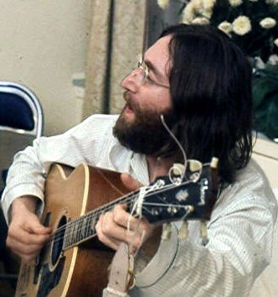
Random Walk Illustration
Query: R(Lennon, PlaysInstrument, ?)

Slide 62
Q & A

Slide 63
Recent Random Walk Methods
PRA: Path Ranking Algorithm
Performs random walk of imperfect knowledge graph
Estimates transition probabilities using KG
For each relation, learns parameters for paths through the KG
ProPPR: Programming with Personalized PageRank
Constructs proof graph
Nodes are partially-ground clauses with one or more facts
Edges are proof-transformations
Parameters are learned for each ground entity and rule

Slide 64
Recent Random Walk Methods
PRA: Path Ranking Algorithm
Performs random walk of imperfect knowledge graph
Estimates transition probabilities using KG
For each relation, learns parameters for paths through the KG
ProPPR: Programming with Personalized PageRank
Constructs proof graph
Nodes are partially-ground clauses with one or more facts
Edges are proof-transformations
Parameters are learned for each ground entity and rule

Slide 65
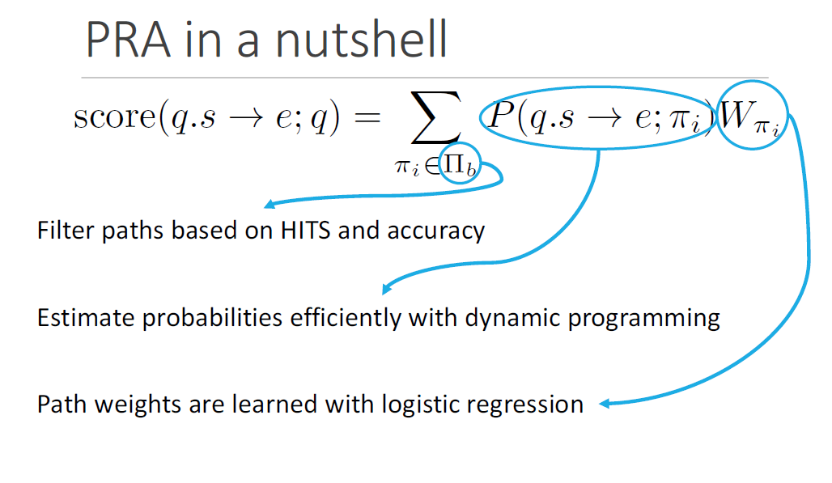
PRA in a nutshell
X
score(q.s ! e; q) =
P (q.s ! e; ⇡ )W
i
⇡
i
⇡_{i}2⇧_{b}
Filter paths based on HITS and accuracy
Estimate probabilities efficiently with dynamic programming Path weights are learned with logistic regression
LAO+EMNLP11
Notes:
Hyperlink-Induced Topic Search

Slide 66
Recent Random Walk Methods
PRA: Path Ranking Algorithm
Performs random walk of imperfect knowledge graph
Estimates transition probabilities using KG
For each relation, learns parameters for paths through the KG
ProPPR: ProbLog + Personalized PageRank
Constructs proof graph
Nodes are partially-ground clauses with one or more facts
Edges are proof-transformations
Parameters are learned for each ground entity and rule

Slide 67
ProPPR-ized PRA example
Query Q: R(Lennon, PlaysInstrument, ?)
R( ,Coworker,X) R(X,PlaysInstrument,Y)
R( ,AlbumArtist,J) R(J,HasInstrument,K)
Unbound variables in proof tree!

Slide 68
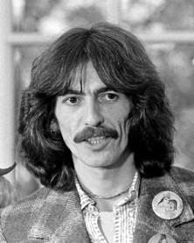

ProPPR-ized PRA example
Query Q: R(Lennon, PlaysInstrument, ?)
R( ,Coworker,X) R(X,PlaysInstrument,Y)
R( ,Coworker, ) R( ,PlaysInstrument,Y)
R( ,AlbumArtist,J) R(J,HasInstrument,K)

Slide 69
ProPPR-ized PRA example
Query Q: R(Lennon, PlaysInstrument, ?)
R( ,Coworker,X) R(X,PlaysInstrument,Y)
R( ,AlbumArtist,J) R(J,HasInstrument,K)
R( ,Coworker, )
R( ,PlaysInstrument,Y)

Slide 70

ProPPR-ized PRA example
Query Q: R(Lennon, PlaysInstrument, ?)
R( ,Coworker,X) R(X,PlaysInstrument,Y)
R( ,Coworker, ) R( ,PlaysInstrument,Y)
R( ,AlbumArtist,J) R(J,HasInstrument,K)

Slide 71
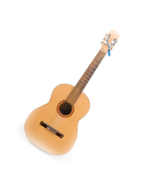
ProPPR-ized PRA example
Query Q: R(Lennon, PlaysInstrument, ?)
R( ,Coworker,X) R(X,PlaysInstrument,Y)
R( ,Coworker, ) R( ,PlaysInstrument,Y)
R( ,Coworker, ) R( ,PlaysInstrument, )
R( ,AlbumArtist,J) R(J,HasInstrument,K)

Slide 72

ProPPR-ized PRA example
Query Q: R(Lennon, PlaysInstrument, ?)
R( ,Coworker,X) R(X,PlaysInstrument,Y)
R( ,Coworker, ) R( ,PlaysInstrument,Y)
R( ,Coworker, ) R( ,PlaysInstrument, )
R( ,AlbumArtist,J) R(J,HasInstrument,K)
R( ,AlbumArtist, ) R( ,HasInstrument,K)

Slide 73
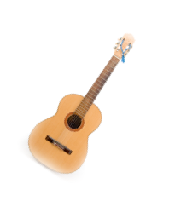
ProPPR-ized PRA example
Query Q: R(Lennon, PlaysInstrument, ?)
R( ,Coworker,X) R(X,PlaysInstrument,Y)
R( ,Coworker, ) R( ,PlaysInstrument,Y)
R( ,Coworker, ) R( ,PlaysInstrument, )
R( ,AlbumArtist,J) R(J,HasInstrument,K)
R( ,AlbumArtist, ) R( ,HasInstrument,K)
R( ,AlbumArtist, ) R( ,HasInstrument, )

Slide 74
ProPPR-ized PRA example
Query Q: R(Lennon, PlaysInstrument, ?)
R( ,Cowor R(X,PlaysInstru
ker,X) R( ,
ment,Y) R(J,HasI
) R(
ent,Y) R( ,
AlbumArtist,J) nstrument,K)
R( ,Coworker, R( ,PlaysInstrum
,AlbumArtist, ) HasInstrument,K)
R( ,Coworker, ) R( ,PlaysInstrument, )
R( ,AlbumArtist, ) R( ,HasInstrument, )

Slide 75
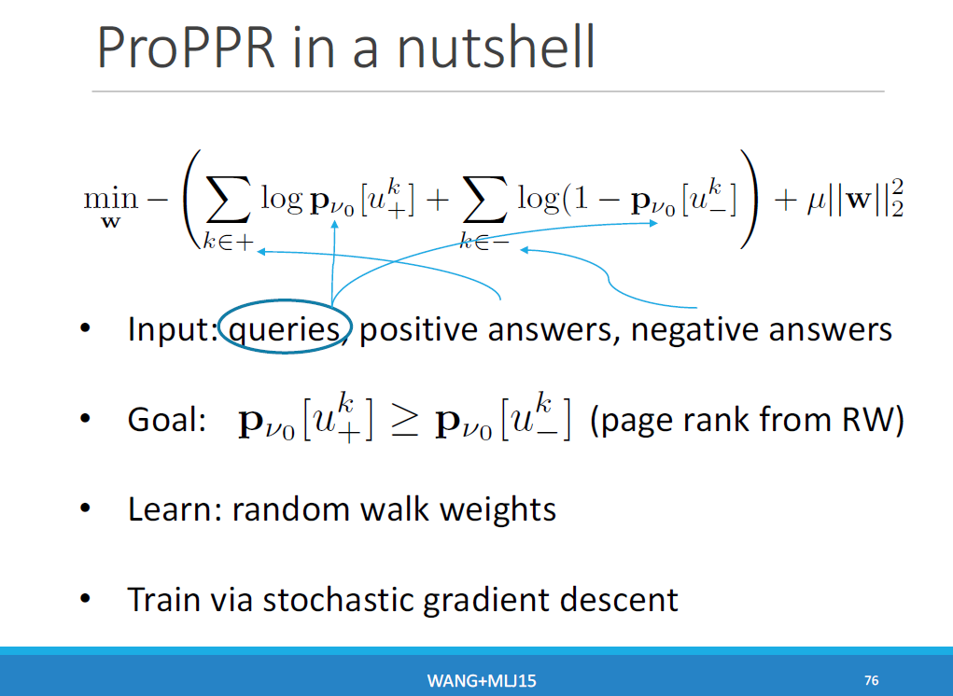
ProPPR in a nutshell
!
X
X
min —
log p
k
k
2
⌫
[u ] +
log(1 —
p [u ]
+ µ||w||
w
0 +
⌫
0 —
2
k2+
k2—
Input: queries, positive answers, negative answers
k
0 + 0 —
Goal:
p⌫ [u
k
] ≤ p [u ] (page rank from RW)
⌫
Learn: random walk weights
Train via stochastic gradient descent
WANG+MLJ15
Notes:
We implemented SGD because it is fast and has been adapted to parallel learning task

Slide 76








Results from PRA and ProPPR
Task:
1M extractions for 3 domains;
~100s of training queries
~1000s of test queries
AUC of extractions alone is 0.7
0.96
Relation Prediction AUC
0.95
0.94
PRA (1M) ProPPR (1M)
0.93
0.92
Google
Beatles
Baseball
WANG+MLJ15

Slide 77
Random Walks: Pros/Cons
BENEFITS
KG query estimation independent of KG size
Model training produces interpretable, logical rules
Robust to noisy extractions through probabilistic form
DRAWBACKS
Full KG completion task inefficient
Training data difficult to obtain at scale
Input must follow probabilistic semantics

Slide 78

Two classes of Probabilistic Models
GRAPHICAL MODELS
Possible facts in KG are variables
Logical rules relate facts
Probability rules
Universally-quantified
RANDOM WALK METHODS
Possible facts posed as queries
Random walks of the KG constitute “proofs”
Probability path lengths/transitions
Locally grounded
satisfied

